Slide 1

PREDICTION OF AGRICULTURE CROP PRODUCTION IN INDIA
Internship Presentation – Data Science and Machine Learning
IILM University, Greater Noida, U.P.
Student: Yash Arvind
Enrollment No.: 25SCS1003002423
Program: B.Tech CSE (AIML) | 2nd Year, 3rd Semester
Organization: UpSkill Campus / UniConverge Technologies Pvt. Ltd.
Internship Period: 20-07-2026 to 20-08-2026
IILM University | Yash Arvind | 1

Slide 2
1. Internship Overview
Domain: Data Science and Machine Learning
Role: Data Science and Machine Learning Intern
Mode: Remote
Internship period: 20 July 2026 – 20 August 2026
Focus: practical machine learning workflow and an applied crop production prediction project
Core workflow: data preparation → feature engineering → model training → evaluation → documentation
IILM University | Yash Arvind | 2

Slide 3
2. Project Introduction
Agricultural production varies across crops and years and is influenced by multiple factors.
Historical production, cultivated area, and yield records can provide predictive signals.
The project frames future production estimation as a supervised regression problem.
Goal: estimate the next year’s crop production from the previous year’s agricultural indicators.
IILM University | Yash Arvind | 3

Slide 4
3. Dataset and Features
55 crop / foodgrain categories
Historical period: 2006–07 to 2010–11
Original data: production, area, and yield for each year
Lag transformation produced 220 supervised samples
Input features: Previous Production, Previous Area, Previous Yield + encoded Crop
Target: Target Production for the following year
IILM University | Yash Arvind | 4

Slide 5
4. System Architecture
Historical
Agriculture Data
Preprocessing &
Feature Engineering
Regression
Models
Evaluation &
Comparison
Production
Prediction
IILM University | Yash Arvind | 5

Slide 6
5. Methodology
1. Load and inspect historical agriculture data
2. Reshape yearly records into lag-based supervised examples
3. Encode crop category and prepare model inputs
4. Train Linear Regression, Ridge, Random Forest, and Gradient Boosting
5. Evaluate using MAE, RMSE, and R²
6. Compare models and select the strongest result
IILM University | Yash Arvind | 6

Slide 7
6. Models Evaluated
Linear Regression – simple and interpretable baseline
Ridge Regression – regularized linear model
Random Forest Regression – nonlinear ensemble of decision trees
Gradient Boosting Regression – sequential boosting of weak learners
The comparison tests whether added model complexity improves prediction on the available dataset.
IILM University | Yash Arvind | 7

Slide 8
7. Model Performance
Model | MAE | RMSE | R²
Linear Regression | 35.1456 | 57.1770 | 0.9384
Gradient Boosting | 37.8912 | 57.2286 | 0.9383
Ridge Regression | 38.6284 | 66.1728 | 0.9175
Random Forest | 43.9643 | 85.4855 | 0.8624
IILM University | Yash Arvind | 8

Slide 9
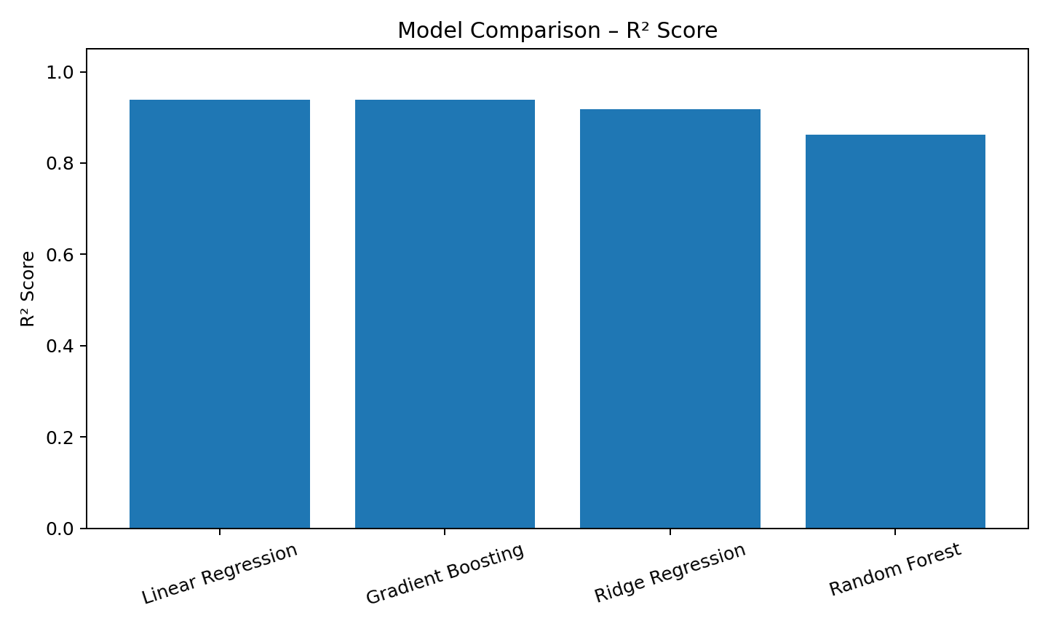
8. Results – R² Comparison
IILM University | Yash Arvind | 9

Slide 10
9. Best Model and Interpretation
Best overall result: Linear Regression
MAE: 35.1456
RMSE: 57.1770
R²: 0.9384
Gradient Boosting was close with R² 0.9383, but had slightly higher error.
The result suggests a strong relationship between the selected historical indicators and subsequent production in this dataset.
IILM University | Yash Arvind | 10

Slide 11
10. Technology Stack
Python
Pandas and NumPy – data preparation
Scikit-learn – regression models and evaluation
Matplotlib – visualization
Git and GitHub – project version control and submission
IILM University | Yash Arvind | 11

Slide 12
11. Key Learnings
Built an end-to-end supervised learning workflow
Learned practical lag-based feature engineering
Compared models using MAE, RMSE, and R²
Improved understanding of model selection and dataset limitations
Strengthened Python, data handling, visualization, and GitHub skills
Learned that a simpler model can outperform more complex models on a small structured dataset
IILM University | Yash Arvind | 12

Slide 13
12. Future Scope
Expand the dataset across more years and regions
Add rainfall, temperature, soil, irrigation, fertilizer, and geographic variables
Explore time-series and sequence-based models
Use stronger chronological cross-validation
Build crop- and region-specific forecasts
Deploy predictions through a dashboard or API with uncertainty ranges
IILM University | Yash Arvind | 13

Slide 14
13. Conclusion
The project demonstrated an end-to-end ML approach for agricultural production prediction.
Historical production, area, and yield were transformed into supervised features.
Four regression models were evaluated quantitatively.
Linear Regression achieved the strongest recorded performance: R² 0.9384, MAE 35.1456, RMSE 57.1770.
The work provides a practical baseline that can be extended with richer agricultural and environmental data.
IILM University | Yash Arvind | 14

Slide 15
14. Project Repository
GitHub repository:
https://github.com/Dyza-CZN/Agriculture-Crop-Production-ML---UpskillCampus.git
The academic submission repository will separately contain the final Internship Report, Internship PPT, and Internship Certificate.
IILM University | Yash Arvind | 15

